Slide 1
Threaded Binary Tree
By
Prof. Amruta Hingmire

Slide 2
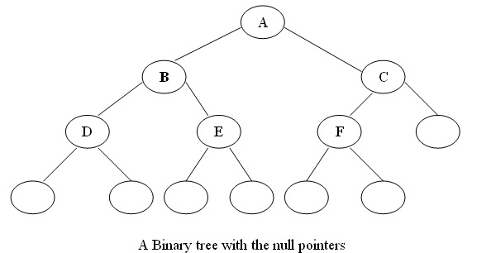
What is Threaded Binary Tree??
In a linked representation of a binary tree, the number of null links (null pointers) are actually more than non-null pointers.
Consider the following binary tree:

Slide 3
What is Threaded Binary Tree??
In above binary tree, there are 7 null pointers & actual 5 pointers.
In all there are 12 pointers.
We can generalize it that for any binary tree with n nodes there will be (n+1) null pointers and 2n total pointers.
The objective here to make effective use of these null pointers.
A. J. perils & C. Thornton jointly proposed idea to make effective use of these null pointers.
According to this idea we are going to replace all the null pointers by the appropriate pointer values called threads.

Slide 4
What is Threaded Binary Tree??
And binary tree with such pointers are called threaded tree.
In the memory representation of a threaded binary tree, it is necessary to distinguish between a normal pointer and a thread.
Defination:
"A binary tree is threaded by making all right child pointers that would normally be null point to the inorder successor of the node (if it exists), and all left child pointers that would normally be null point to the inorder predecessor of the node.”

Slide 5
Types of threaded binary trees:
Single Threaded: each node is threaded towards either the in-order predecessor or successor (left or right) means all right null pointers will point to inorder successor OR all left null pointers will point to inorder predecessor.
Double threaded: each node is threaded towards both the in-order predecessor and successor (left and right) means all right null pointers will point to inorder successor AND all left null pointers will point to inorder predecessor.

Slide 6
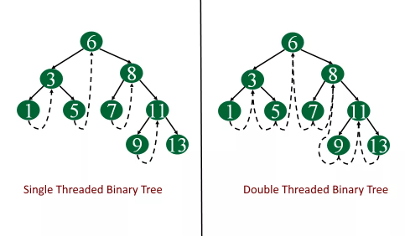
Types of threaded binary trees:

Slide 7
Implementation: Structure of TBT
struct node
{
int data;
int leftbit; //can be Boolean also
int rightbit;
struct node *left;
struct node *right;
};

Slide 8
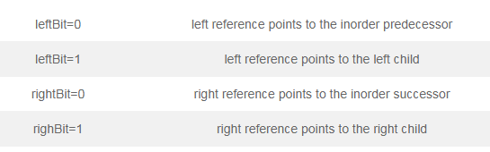
Implementation:

Slide 9
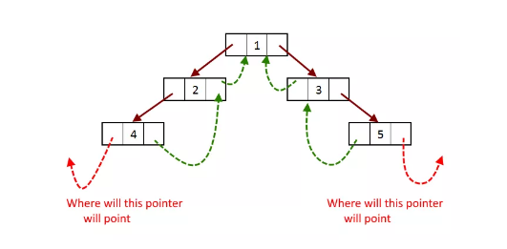
Implementation:

Slide 10
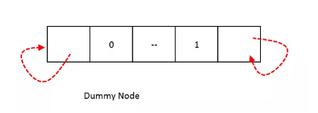
Need of a Dummy Node:
Need of a Dummy Node: As we saw that references, left most reference and right most reference pointers has nowhere to point to so we need a dummy node.
In this dummy node we will put rightBit = 1 and its right child will point to it self and leftBit = 0, so we will construct the threaded tree as the left child of dummy node.

Slide 11
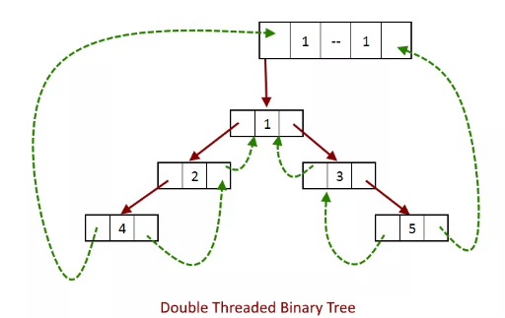
Need of a Dummy Node:

Slide 12
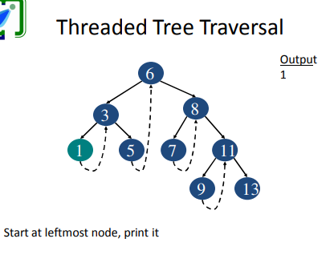
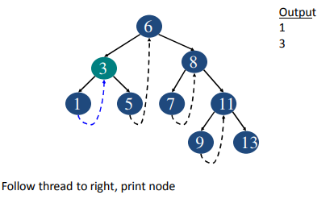
Traversal in TBT (Inorder)

Slide 13
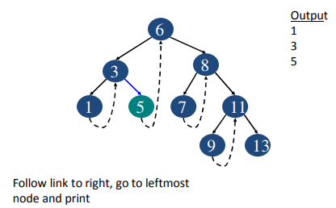
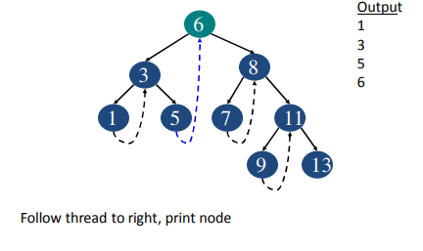
Traversal in TBT (Inorder)

Slide 14
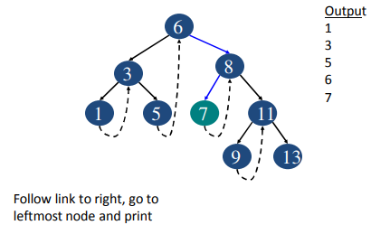
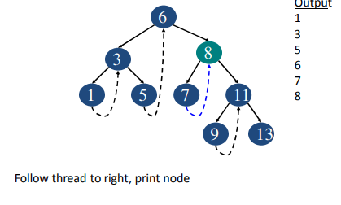
Traversal in TBT (Inorder)

Slide 15
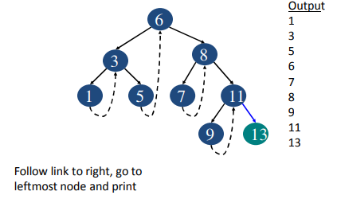
Traversal in TBT (Inorder)

Slide 16
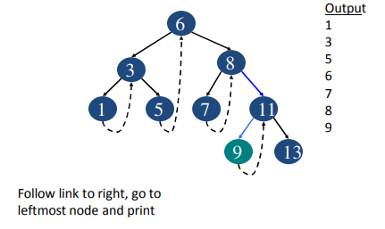
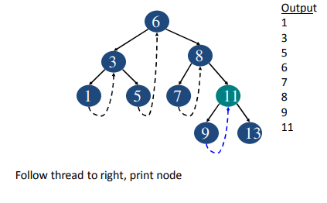
Traversal in TBT (Inorder)

Slide 17
Advantages of threaded binary tree:
Advantages of threaded binary tree:
Any node can be accessible from any other node. Threads are usually more to upward whereas links are downward. Thus in a threaded tree, one can move in their direction and nodes are in fact circularly linked. This is not possible in unthreaded counter part because there we can move only in downward direction starting from root.
Insertion into and deletions from a threaded tree are although time consuming operations but these are very easy to implement.

Slide 18
Disadvantages of threaded binary tree:
Disadvantages of threaded binary tree:
Insertion and deletion from a threaded tree are very time consuming operation compare to non-threaded binary tree.
This tree require additional bit to identify the threaded link.

